Slide 1

NYKAA ANALYSIS
KARPAGAM K

Slide 2
AGENDA
Company Overview
Business Model
Market Position
SWOT Analysis
Key Strategies
Conclusion

Slide 3
Company Overview
Founded: 2012 by Falguni Nayar
Headquarters: Mumbai, India
Business Model: Beauty, wellness, personal care, and fashion retail via online platform + offline stores (omnichannel)
IPO: Listed on NSE & BSE in 2021, one of the most successful Indian startup IPOs.

Slide 4
Business Model
E-commerce Platform – Core business through Nykaa.com and mobile app.
Omnichannel Retail – Over 100 physical stores across India.
Nykaa Fashion – Extension into apparel, accessories, and lifestyle.
Private Label Products – Own beauty brands (e.g., Nykaa Cosmetics, Nykaa Naturals) with higher margins.
Content + Commerce Strategy – Beauty blogs, tutorials, and influencer collaborations drive engagement and conversion.

Slide 5
Market Position
Leading Online Beauty Retailer in India with strong brand recall.
Competes with Amazon Beauty, Flipkart, Myntra, Purplle, and Sephora India.
Differentiates by curating authentic products and building trust in a market plagued by counterfeit goods.

Slide 6
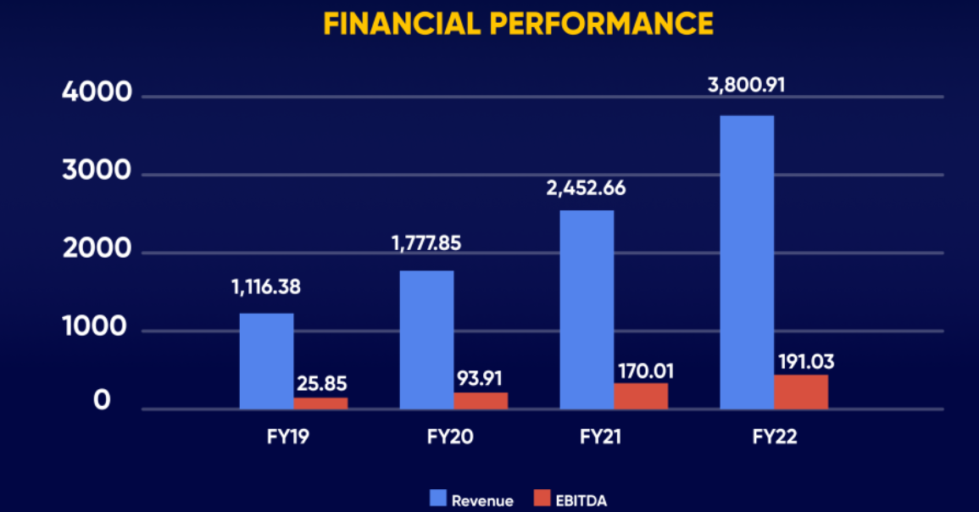
Financial Snapshot Nykaa’s Revenue Growth Trends
Annual Revenue (FY21–FY24)
FY21: Nykaa posted its first net profit of approximately ₹61.9 crore, with revenue rising sharply by 55% YoY to around ₹3,774 crore.
FY22: Continued expansion led to dual-digit growth in both revenue and GMV.
FY23: Revenue grew by 36% to ₹5,144 crore, but net profit more than halved to ₹19 crore due to rising expenses.
FY24: Revenue increased 24% to ₹6,386 crore, and PAT nearly doubled to ₹40 crore.
FY25: Yet another 24% growth brought revenue to ₹7,950 crore, with profit climbing to ₹72–74 crore. EBITDA margins also improved notably.

Slide 7
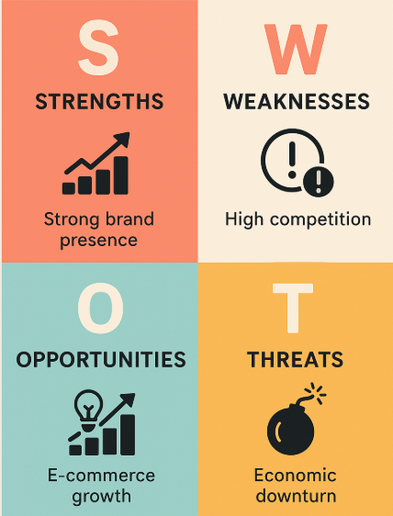
SWOT ANALYSIS

Slide 8
Strengths (Internal Positive Factors)
Strong Brand Equity – Nykaa is a well-recognized beauty and lifestyle brand in India, trusted by millions of consumers.
Wide Product Range – Offers cosmetics, skincare, personal care, fashion, and luxury products from global and domestic brands.
Omnichannel Presence – Strong online marketplace combined with offline retail stores.
Celebrity & Influencer Backing – Effective use of influencers and Bollywood partnerships to attract customers.
First-Mover Advantage – One of the earliest players in online beauty retail in India, creating customer loyalty.

Slide 9
Weaknesses (Internal Negative Factors)
High Competition in Pricing – Competes with Amazon, Flipkart, Myntra, and brand-owned websites that offer heavy discounts.
High Marketing Spend – Heavy reliance on promotions and influencer campaigns increases costs.
Low International Presence – Limited global operations compared to players like Sephora.
Logistics Challenges – Ensuring timely delivery in Tier-2 and Tier-3 cities can be difficult.
Dependency on E-commerce – Vulnerable to changes in consumer buying behavior or digital regulations.

Slide 10
Opportunities (External Positive Factors)
Growing E-commerce Market in India – Increasing internet penetration and digital payments boost online shopping.
Expansion into Fashion & Lifestyle – Nykaa Fashion provides opportunities to diversify revenue.
Rising Beauty & Personal Care Demand – India’s young population and growing disposable incomes fuel demand.
International Expansion – Scope to enter global beauty and fashion markets.
Sustainability & Clean Beauty – Growing demand for eco-friendly, cruelty-free, and organic products.

Slide 11
Threats (External Negative Factors)
Intense Competition – From e-commerce giants, local startups, and international beauty retailers.
Economic Downturns – Reduced spending on non-essential luxury products during inflation or recession.
Changing Consumer Preferences – Fast-evolving beauty trends may reduce demand for existing products.
Counterfeit Products Risk – Fake or low-quality products could damage brand reputation.
Regulatory Challenges – Import/export restrictions, data privacy laws, and e-commerce regulations could impact operations.

Slide 12
Key Strategies
1. Expansion
Strengthening offline presence with 150+ retail stores across metros & Tier-2 cities.
Expanding fashion, wellness & men’s grooming verticals alongside core beauty business.
2. Digital Marketing & Brand Building
Heavy use of influencer-driven campaigns (YouTube, Instagram, Nykaa Army).
Building strong loyalty programs (Nykaa Prive) to retain high-value customers.
Personalized content & beauty tutorials to boost engagement.
3. Private Labels
Growing in-house brands like Nykaa Cosmetics, Nykaa Naturals, Kay Beauty (Katrina Kaif).
Higher margins vs third-party products → boosts profitability.
Positioning private labels in affordable + premium categories.
4. Technology & Personalization
AI/ML-driven product recommendations & virtual try-on tools.
Data-driven personalization for shopping experience.
Seamless omnichannel integration between app, website & offline stores.

Slide 13
Conclusion
Summary
Nykaa has built a strong brand presence in India’s beauty & lifestyle market.
Its omnichannel model (online + offline) ensures wide reach and customer trust.
Despite profitability challenges due to high costs, the company continues to show steady revenue growth.
Expansion into fashion, men’s grooming, and wellness diversifies its portfolio.
Growth Outlook
Sustained revenue growth expected from Tier-2 & Tier-3 cities.
Private labels & exclusive partnerships will strengthen margins.
AI-driven personalization & digital innovation will enhance customer loyalty.
Long-term potential in luxury, international expansion, and lifestyle segments.
Nykaa is positioned to remain a leader in India’s beauty and lifestyle e-commerce, with strong opportunities for expansion and digital-led growth.

